Slide 1
Story Sharing Website
Noyan
Gordon
Soham

Slide 2
Idea
Create a story sharing website for new or aspiring writers
People can write about what they want e.g. stories, auto-biographies etc.
Easily accessible and not too complex
Writers can make money through writing
Copying and pasting disabled
Writers cannot get reputation points without publishing stories

Slide 3
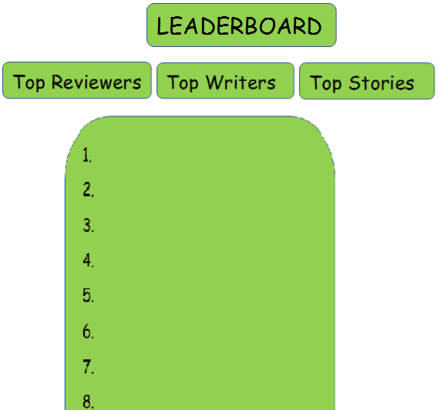
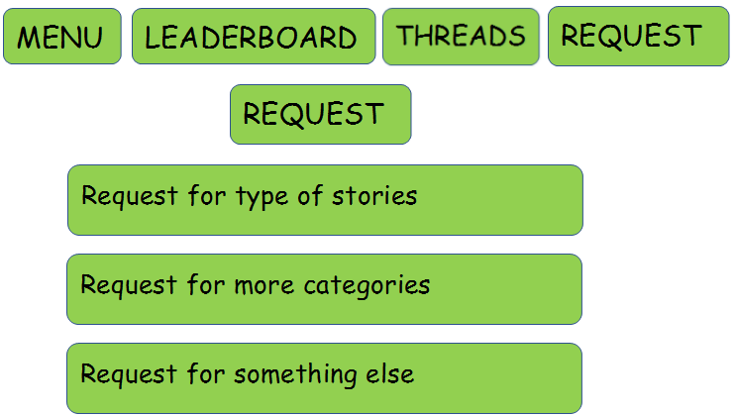
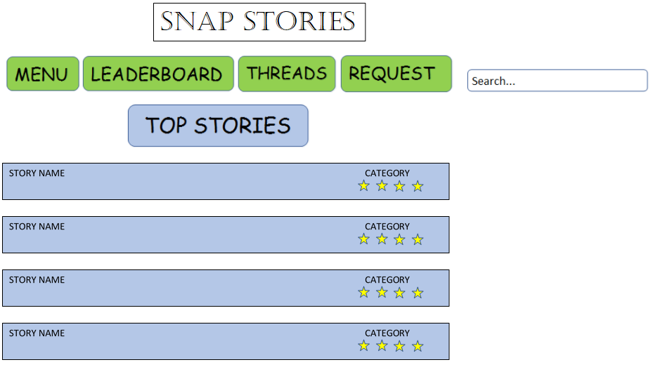
Unique Selling Point
Target audience is everyone who enjoys reading and writing
It is very simple to use
Gap in market
Writers can kick-start careers without resources needed for publishing
Basic Design:

Slide 4
Plan of website:
Insert Pictures here…

Slide 5
Finance Plan
Readers can read up to 2 pages before payment is necessary
Writers get 5 free stories before they have to pay for money but we get 30% of the profits
When writer starts paying for stories, we take 15% of revenue
Writer sets price of story, but we have algorithm running showing optimal price based on story length and user reputation points
Writers can subscribe which will give discounted price per story upload
Ad revenue
Ad free experience (Only £1.99 per month)

